Slide 1


Slide 2
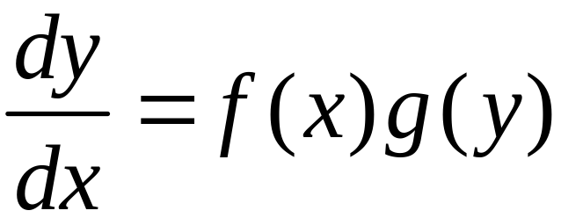
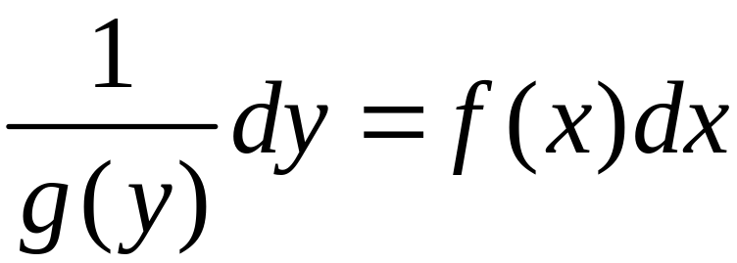
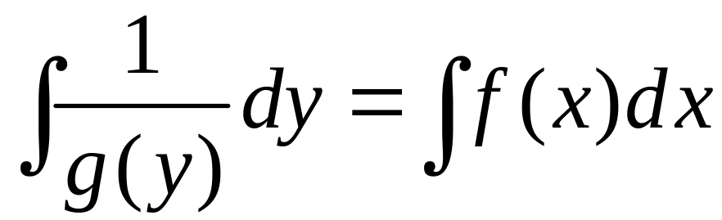
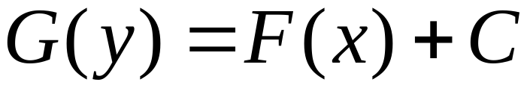
Separable differential equations
Separating the variables：
Integration
General solution：
Solution is given in an implicit form

Slide 3

verify：
Yes!

Slide 4
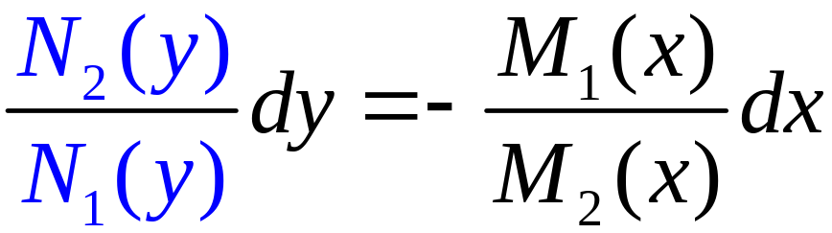
Separable differential equations
Separation of the two variables：

Slide 5
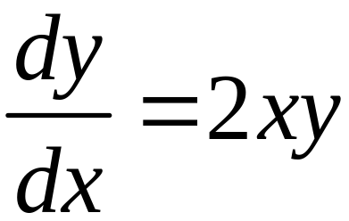
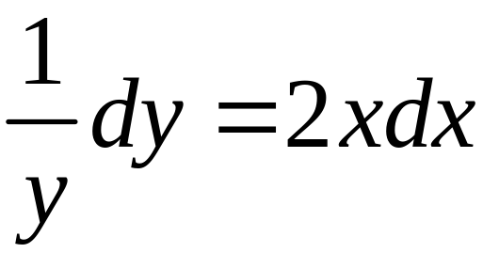
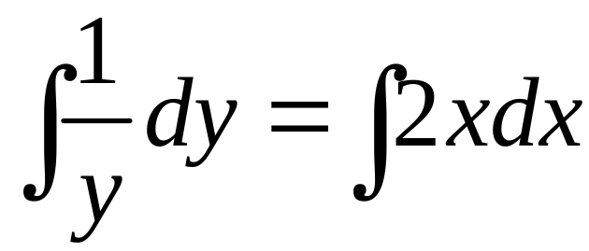
Example 1
Find General solution：
Solution
Separation of the variables：
Integration：
General solution

Slide 6
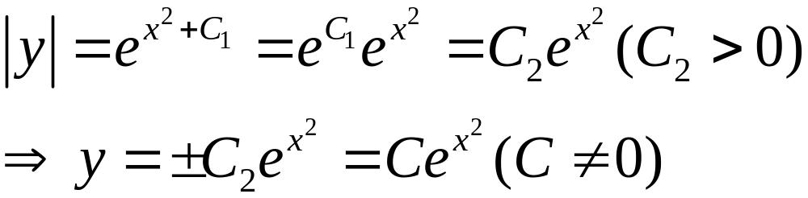
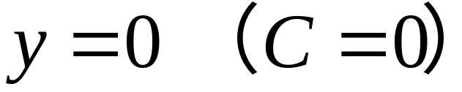
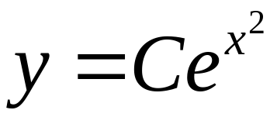
And, is also a solution
So,
is the general solution

Slide 7
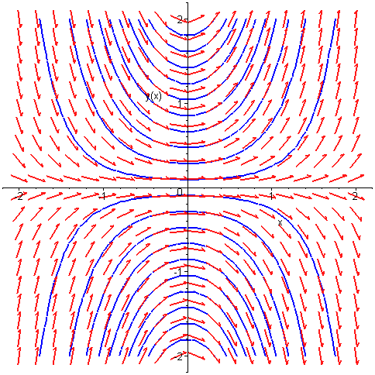
Slope field and integral curves
with(DEtools):with(plots):
wffc:=diff(y(x),x)=2*x*y(x):dsolve(wffc);
fangxiangcang:=DEplot(wffc,y(x),x=-2..2,y=-2..2,thickness=2):
jifenquxian:=contourplot(y/exp(x^2),x=-2..2,y=-2..2,contours=20,color=blue,thickness=2):
display(fangxiangcang,jifenquxian);

Slide 8
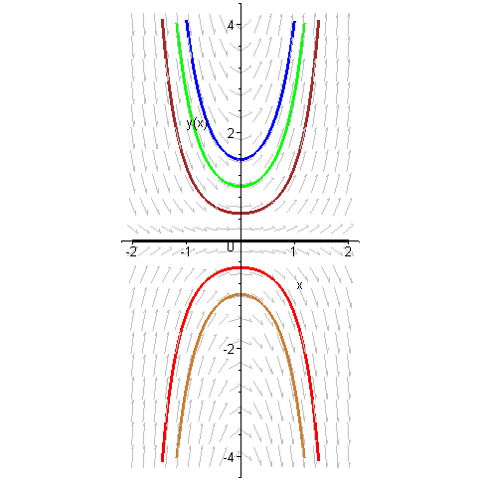



方向场与积分曲线
with(DEtools):
DEplot(diff(y(x),x)=2*x*y(x),y(x),x=-2..2,
[[y(0)=-1],[y(0)=-0.5],[y(0)=0],[y(0)=0.5],[y(0)=1],[y(0)=1.5]],
y=-4..4,linecolor=[gold,black,blue,red,brown,green],
color=grey,stepsize=0.01,scaling=constrained);

Slide 9

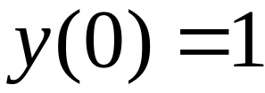
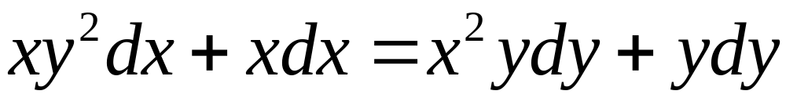
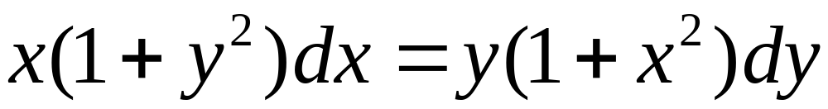
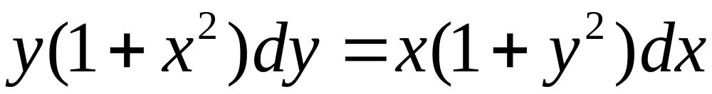
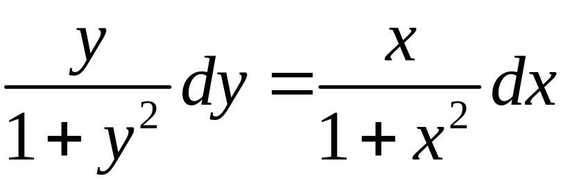
例
求初值问题：
解
整理：
分离变量：

Slide 10
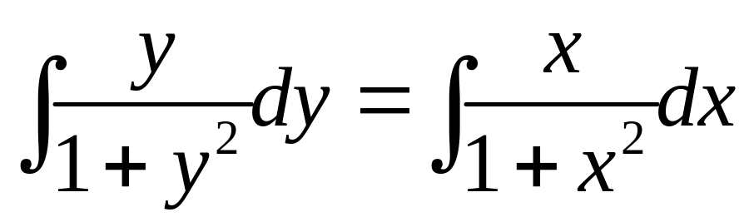
积分：

Slide 11
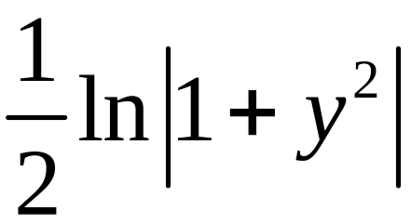
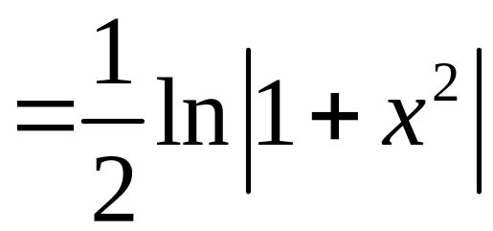
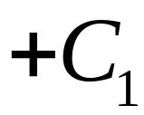
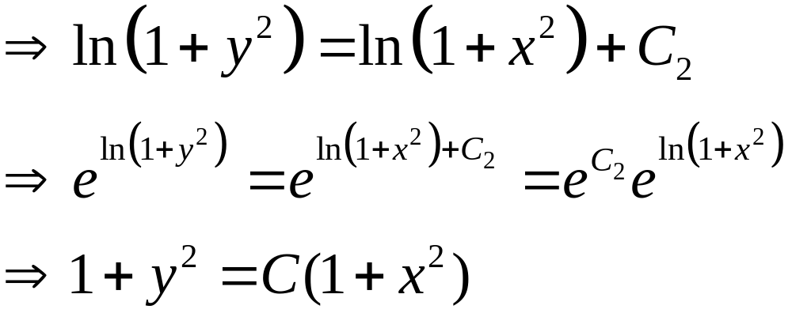
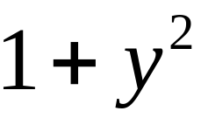
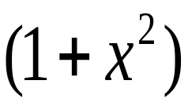

通解：

Slide 12
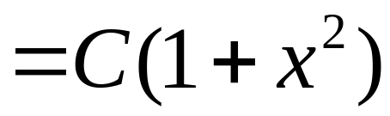
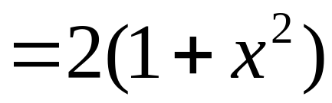
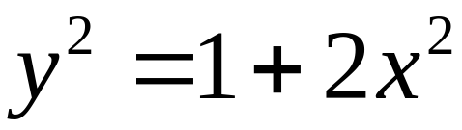
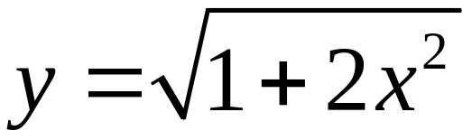

通解：
将 x = 0, y = 1 代入：
2 = C
特解：
双曲线

Slide 13
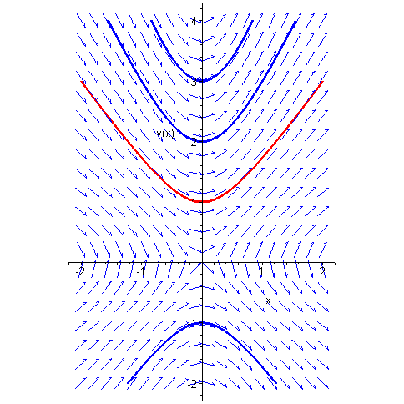
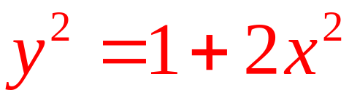
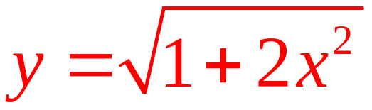
一族双曲线
with(DEtools):
wffc:=y(x)*(1+x^2)*diff(y(x),x)=x*(1+(y(x))^2):DEplot(wffc,y(x),x=-2..2,
y=-2..4,[[y(0)=-1],[y(0)=1],[y(0)=3],[y(0)=2]],linecolor=[blue,red,blue,blue],
color=blue,stepsize=0.01,scaling=constrained);

Slide 14
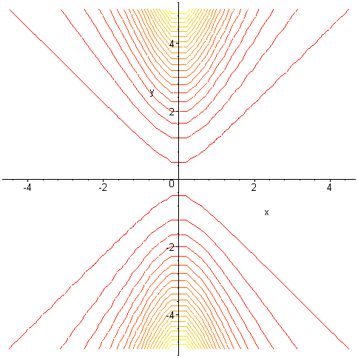
一族双曲线
> with(plots):contourplot((1+y^2)/(1+x^2),x=-5..5,y=-5..5,contours=20);

